Slide 1
Employee Ideation Tool
A digital platform that turns everyday employee ideas into measurable improvement.

Slide 2

Why Employee Ideation?
WHAT CHANGES WITH THE PLATFORM
WHY WE ARE DOING THIS
CHALLENGE TODAY
WITH THE PLATFORM
The people closest to the work see the waste first — a jig that slips, a rework loop, a delivery that always runs late. Most of it is never written down, and what is written down goes into a suggestion box nobody empties.
✕
Ideas lost in a suggestion box
→
✓
One place, tracked end to end
✕
Nobody knows who should approve
→
✓
A named, ordered approval chain
The Result: Every idea captured in one place, routed to the person who can decide, and tracked through to what it actually saved.
✕
The employee never hears back
→
✓
Status, comments and points
Objective — Give every employee a way to raise an improvement, every manager a queue they can act on, and every plant a record of what was implemented and what it was worth.
✕
Savings are never measured
→
✓
ROI recorded on every idea
2
Redefining Quality

Slide 3


What is the Employee Ideation Tool?
A platform where employees raise improvement ideas and somebody actually decides on them. Ideas move up a named approval chain, and approved ones are pushed to the QC tool and tracked to implementation — with the benefit recorded.
Capture
Evaluate
Implement
An employee describes the problem, the proposed solution and the expected benefit, and attaches evidence.
The idea is scored, discussed and moved up the chain until somebody with the authority decides.
Approved ideas go to the QC tool as tracked work, and their ROI is recorded against the original idea.
How it works
WHAT YOU GET OUT OF THE BOX
Employee submits an idea
›
Scored and reviewed
›
Approved up the chain
›
Implemented and measured
7 languages, every screen
6 stages, Draft to Implemented
3
Redefining Quality

Slide 4
Role-Wise Flow, Data Entry and Reports
Four user levels, what each one does, and how information moves between them
Role
What they do
Data entry
Reports
IFQM Platform Admin
Usage and billing only
Onboard Org
Assign Plan
Set Policy
Organisations · Plans
tenant isolation
Never reads an idea
Level 1 · Platform
Organisation Admin
Users · Roles · Departments
Org-wide analytics
Add Users
Set Approval Chain
Configure Branding
Approval chain · Settings
PDF export
Level 2 · Organisation
Setup flows down
Manager / Plant Head
Decisions · Comments
Team and department view
Open Review Queue
Score & Comment
Approve or Escalate
Ideas flow up
PDF export
Level 3 · Approval chain
ROI · Implementation
Employee
Idea · Benefit · Files
Own ideas and points
Sign In (OTP)
Submit Idea
Track Status
Comments · Votes
No export
Level 4 · Shop floor
4
Setup and configuration flow downward · ideas and their outcomes flow upward, stopping at the boundary of each organisation’s own database.
Redefining Quality

Slide 5
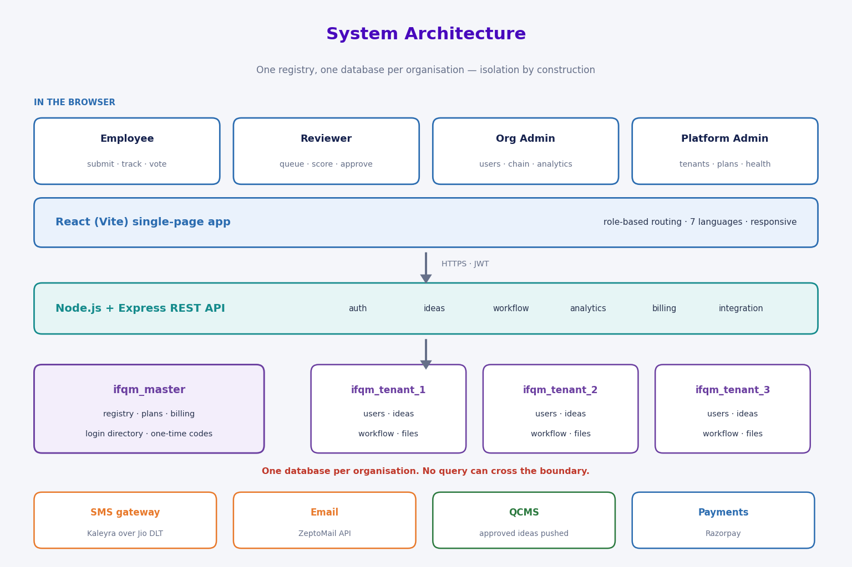
High-Level System Architecture
Frontend
React (Vite) — responsive, role-based UI
Backend / API
Node.js + Express REST server
Database
MySQL — one database per organisation
Hosting
Vercel + Render · Aiven MySQL
Security
HTTPS · JWT · bcrypt · tenant isolation
5
Redefining Quality

Slide 6
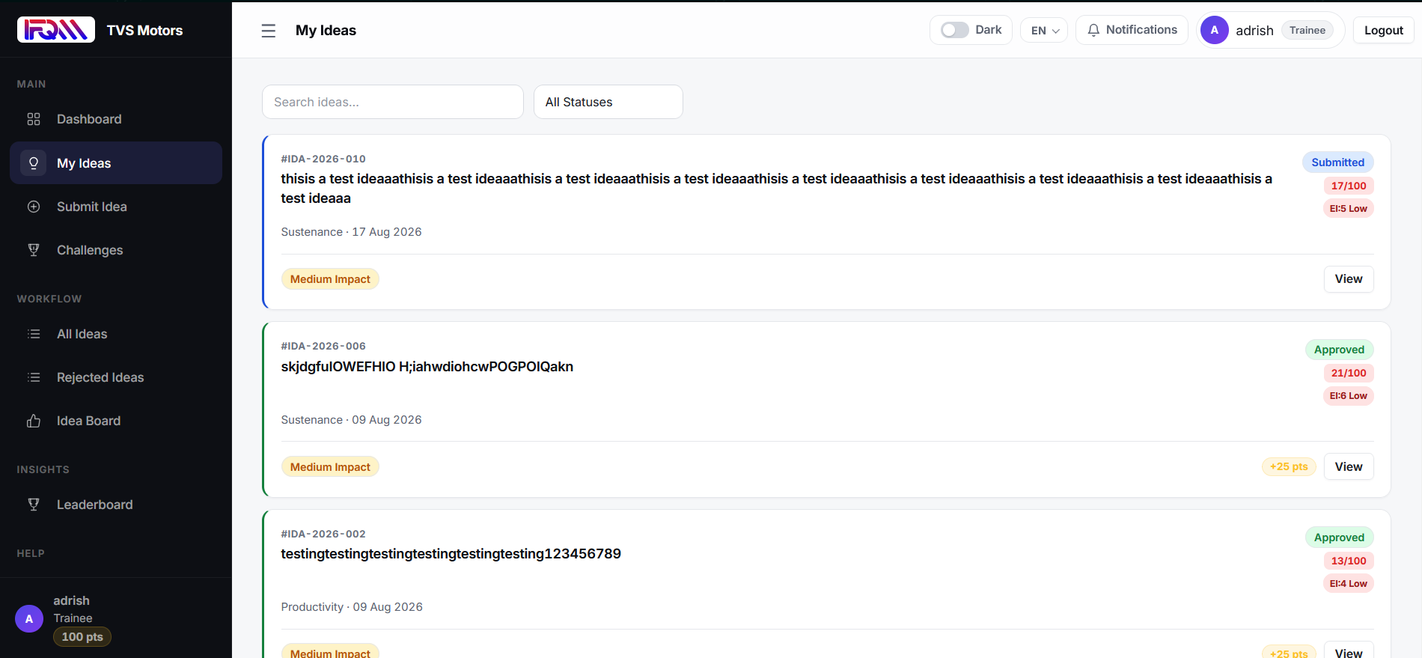
The Employee Experience
Everything an employee needs on one screen: raise an idea, follow it up the chain, and see what it earned.
AT A GLANCE
Submit in minutes
Follow every step
Points and badges
Community board
6
Redefining Quality

Slide 7
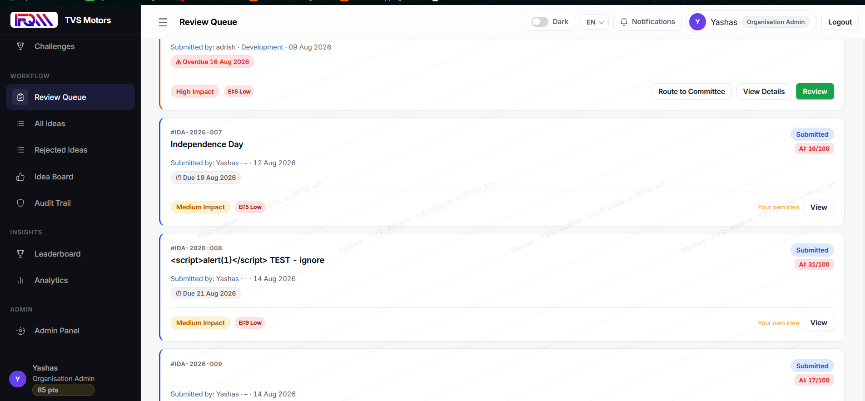
Review and Approval
Reviewers see exactly what is waiting on them, how long it has waited, and who it goes to next.
WHAT A REVIEWER DOES
One clear queue
Score and comment
Approve or escalate
Overdue flagged
7
Redefining Quality

Slide 8
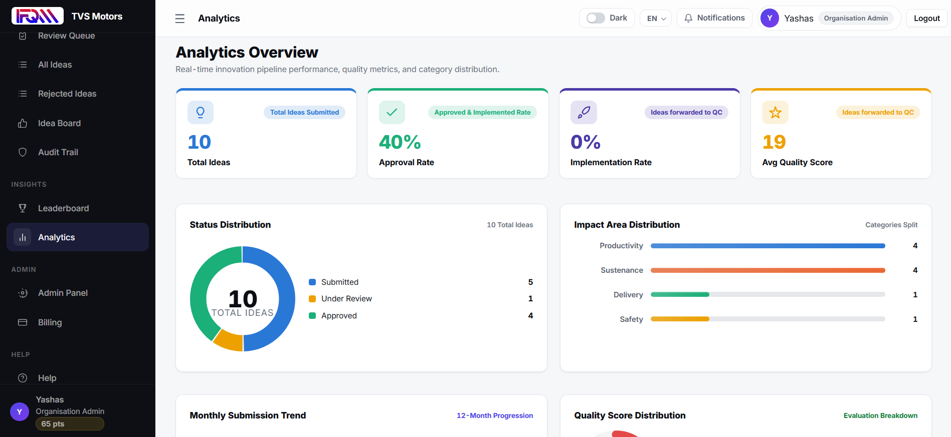
Organisation Analytics
Where ideas come from, how fast they move, and what they are worth.
WHAT AN ADMIN CAN SEE
Approval rate
Implementation rate
Quality score
Department view
8
Redefining Quality

Slide 9
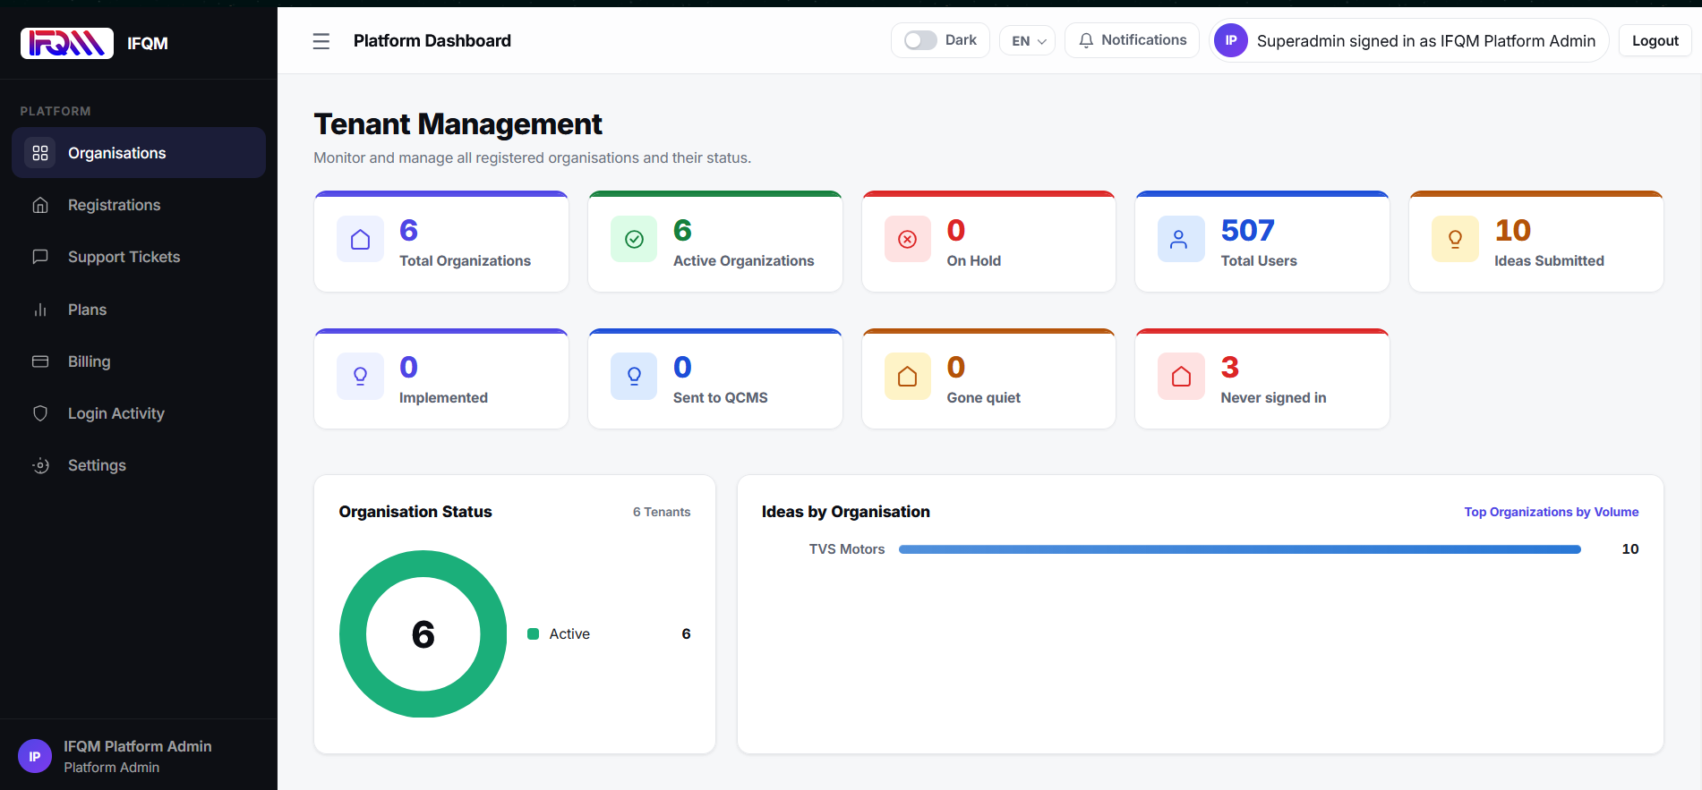
Platform Console — Multi-Tenant
One console to onboard organisations, set their plan and watch the health of the platform — without ever reading a customer’s ideas.
AT A GLANCE
Organisations
Onboard, approve, suspend
Plans & Billing
Trial · Starter · Professional · Lifetime
Usage & Quotas
Requests, users and storage per plan
Support & Health
Tickets, maintenance mode, DB checks
Platform Admin → Organisations · plans · usage · Export to PDF
9
Redefining Quality

